Slide 1

Community Calls 2023 –RPA Invoice processing with RPA & PAM
Nigel T. Crowther
Automation Tech Sales EMEA
IBM Robotic Process Automation
Try it now: https://www.ibm.com/account/reg/ca-en/signup?formid=urx-46597
ncrowther@uk.ibm.com
24th Feb 2022

Slide 2

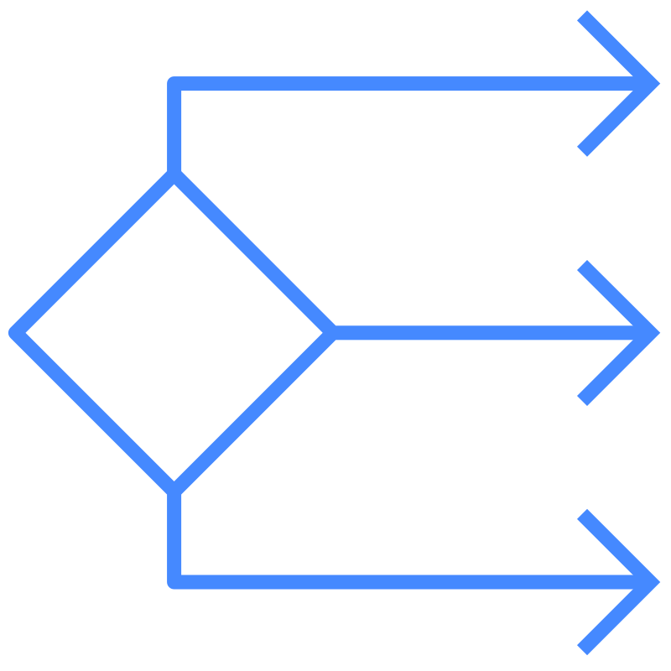
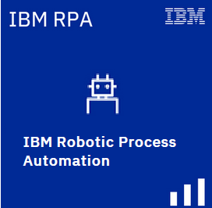
IBM Business Automation Manager Open Editions V8.01
RPA is bundled
Limited to one unattended bot
On prem only
IBM Process Automation Manager Open Edition
IBM Decision Manager
Open Edition
Process Automation and Decision Automation
Decision Automation
Proprietary
Open Source
Notes:
IBM Process Automation Manager Open Edition and IBM Decision Manager Open Edition are fully open-source application development platforms that help clients build highly-customized and scalable cloud-native business automation applications. Clients use Process Automation Manager to model and automate their business processes, including decision automation. They use Decision Manager to focus on decision modeling and automation. Both allow for the rapid development and maintenance of intelligent business automation applications and processes.

Slide 3
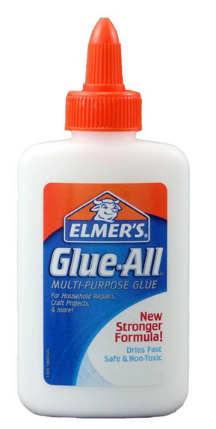
Why IBM RPA?
Universal automation glue
Inexpensive
Easy to use
WARNING:
Can create a mess!
Notes:
IBM Process Automation Manager Open Edition and IBM Decision Manager Open Edition are fully open-source application development platforms that help clients build highly-customized and scalable cloud-native business automation applications. Clients use Process Automation Manager to model and automate their business processes, including decision automation. They use Decision Manager to focus on decision modeling and automation. Both allow for the rapid development and maintenance of intelligent business automation applications and processes.

Slide 4
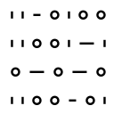



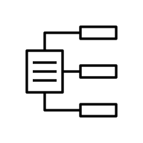

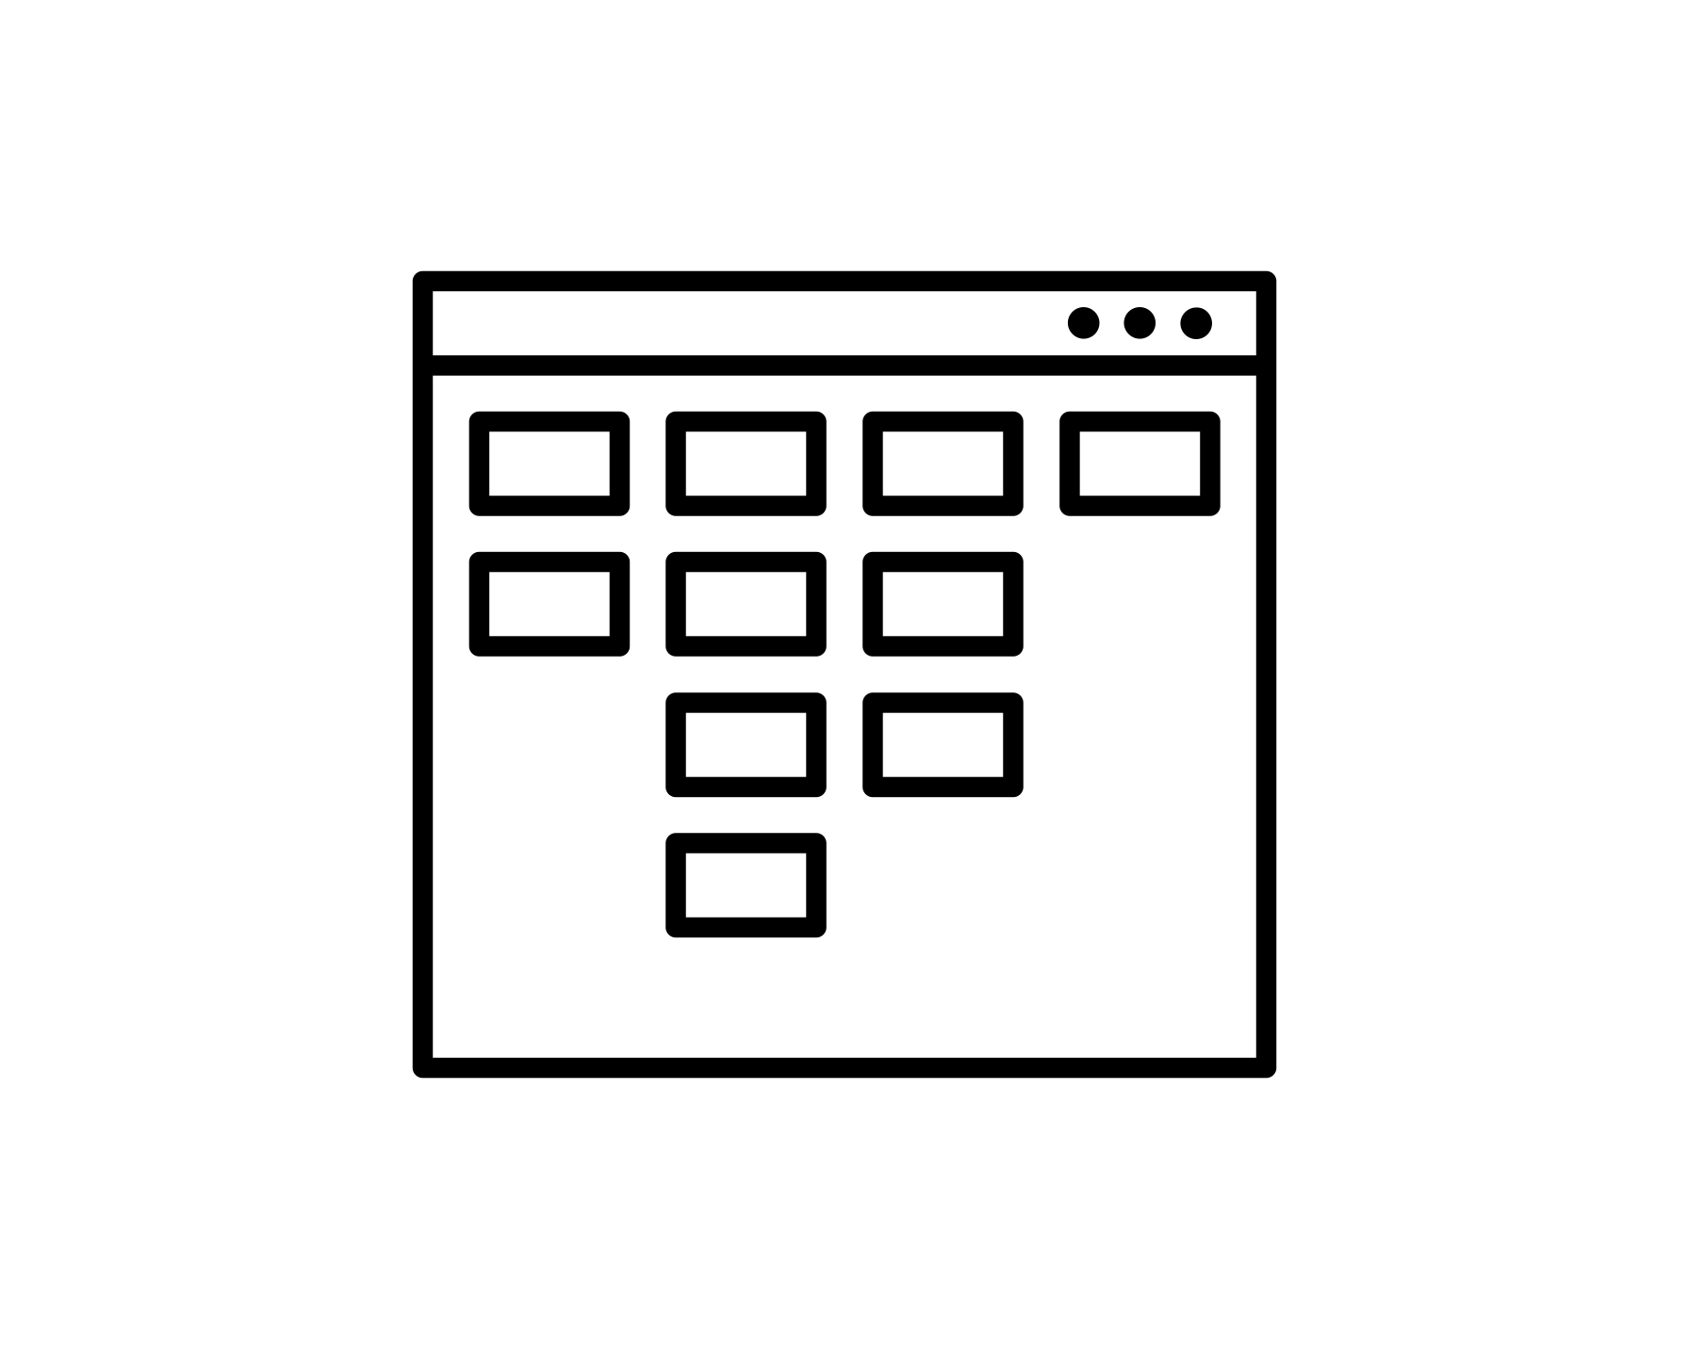


What can bots do?
Use Microsoft Windows
Use file system, clipboard, taskbar, services, open and close applications
Integrate without APIs
Integrate through browsers, Windows apps, SAP, remote desktop, terminals
Interact with systems
Access mainframes, call APIs, update and query databases
Communicate
Send and read emails and SMS messages, chat using text and voice
Read documents
Extract structured data from unstructured content
Apply intelligence
Understand information, make decisions, apply knowledge, learn
Create documents
PDF Reports, MS Excel, MS Word
Process Data
Encrypt, analyze, perform calculations
Process Files
Create, upload/download, transfer
Notes:
Robot Process Automation (RPA) is used to automate tasks that are traditionally performed by people, by mimicking the steps that a person would take when performing activities on their desktop computer.
For example, a software robot (or bot) can be created to gather data from multiple systems, collate the data within a spreadsheet, perform some calculations, and enter the data into another system by using the application user interfaces in exactly the same way a person would do it. Bots can also use traditional techniques to integrate with systems, like SQL to query a database or JSON/HTTP to call a REST service.
Other examples include:
Use Microsoft Windows OS - Use file system, clipboard, taskbar, services, open and close applications
Use desktop applications - Work with web apps, Windows apps, Microsoft Office suite, SAP, Java apps, remote desktop
Interact with systems - Access mainframes, call APIs, update and query databases
Communicate - Send and read emails and SMS messages, chat using text and voice
Read documents - Extract structured data from unstructured content
Apply intelligence - Understand information, make decisions, apply knowledge, learn
Create documents - PDF Reports, MS Excel, MS Word
Process Data - Encrypt, analyze, perform calculations
Process Files - Create, upload/download, transfer

Slide 5







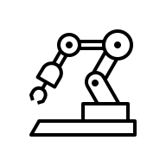
RPA use cases by industry
Banking and insurance
Onboarding
Insurance claims tasks
Loan origination
Energy and utilities
Data collection and reporting
Contracts
Regulations and compliance
IT
Data entry
Capture
Mass email management
Reporting
Data synchronization
Travel and transportation
Payroll
Vehicle checks and reporting
Healthcare
Medical Appointments
Medical bills
Medical claims tasks
Media and communications
Order management
Provisioning
Government
Benefits processing
Eligibility
Self service updates
Retail industry
Refunds
Procurement
Price comparison
Invoice processing

Slide 6


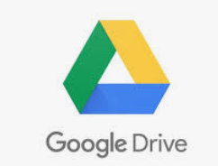
RPA Invoice Processing
Send
Invoice
RPA
Detect & Detach Invoice
OCR
Invoice
Upload Invoice
PAM
Invoice
Approval
OCR
Library
Paid
DM
Email Rules

Slide 7
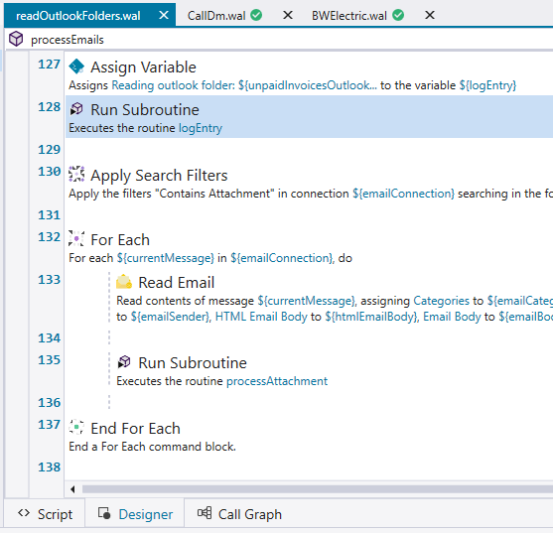
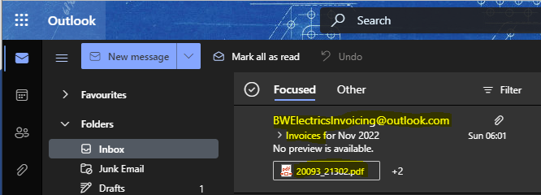
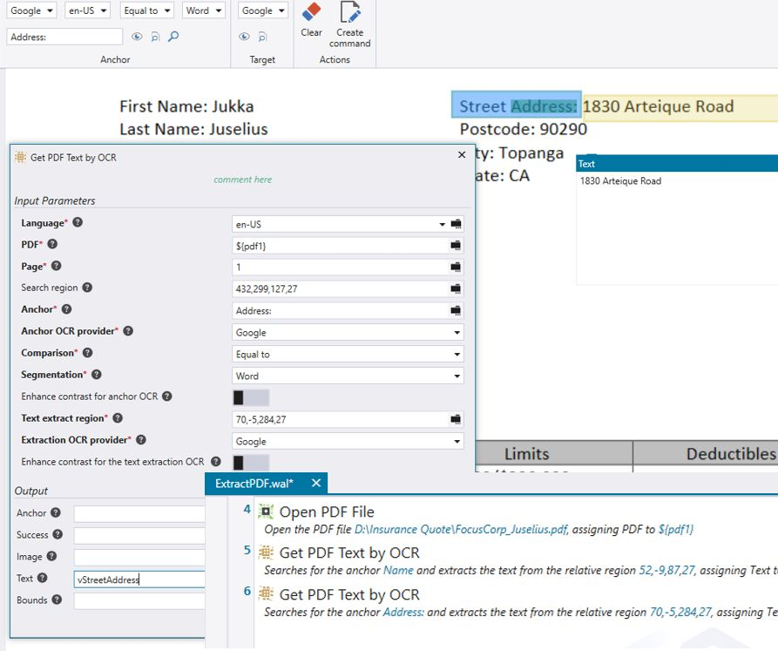

The Email The bot reads emails containing invoices and lets DM decide on how to process them…

Slide 8
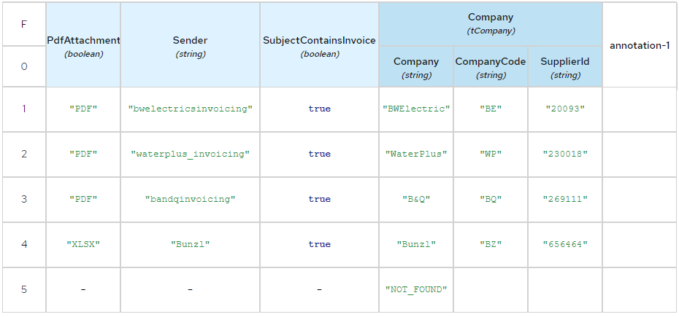
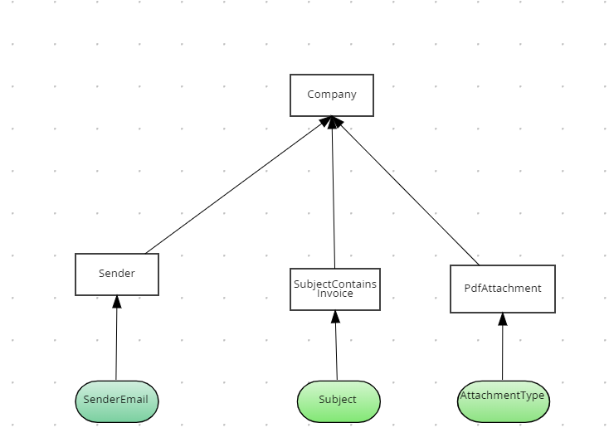
Email Rules DM looks at email header to determine how to process the invoice
DM

Slide 9
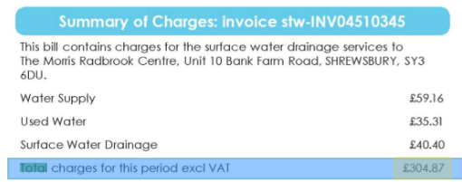
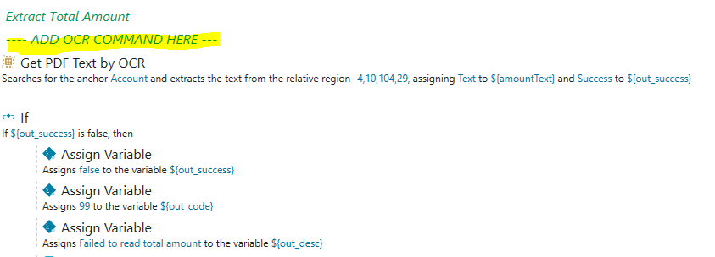
OCR The bot OCRs the invoice and writes the result to an XML file A template OCR script is created for unidentified invoices

Slide 10
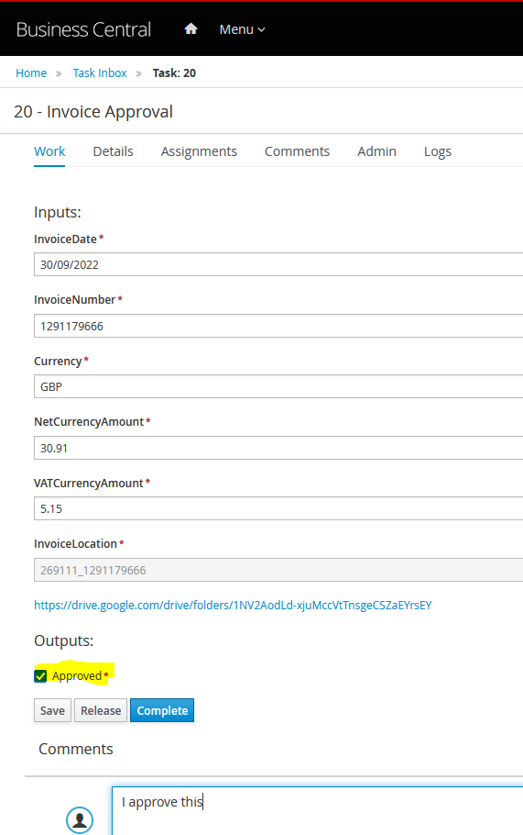
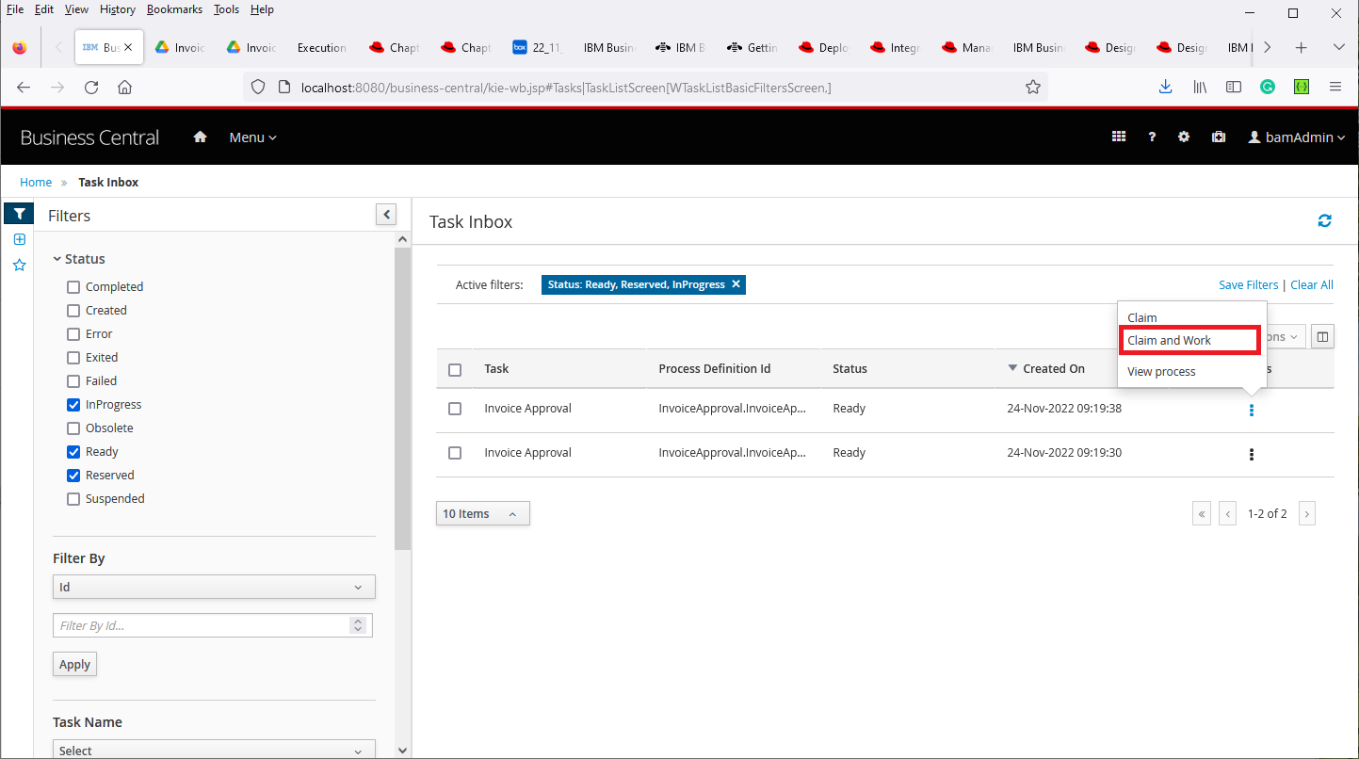
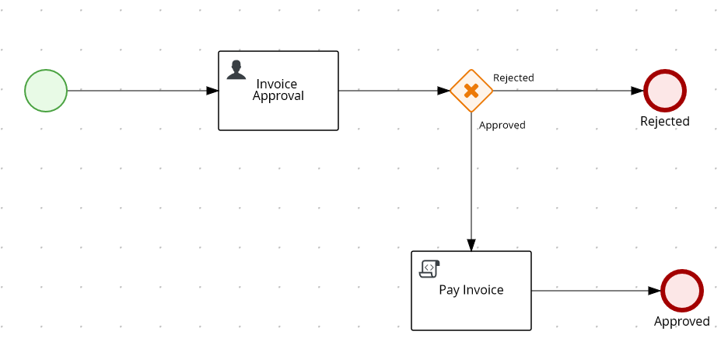
Approval The bot sends the result to PAM, where the invoice amounts are verified/modified and then approved
PAM

Slide 11
Adding new invoices
Define the email rule to detect the invoice
Run bot
Bot automatically creates OCR template
Complete template using OCR tool
Re-reun bot

Slide 12
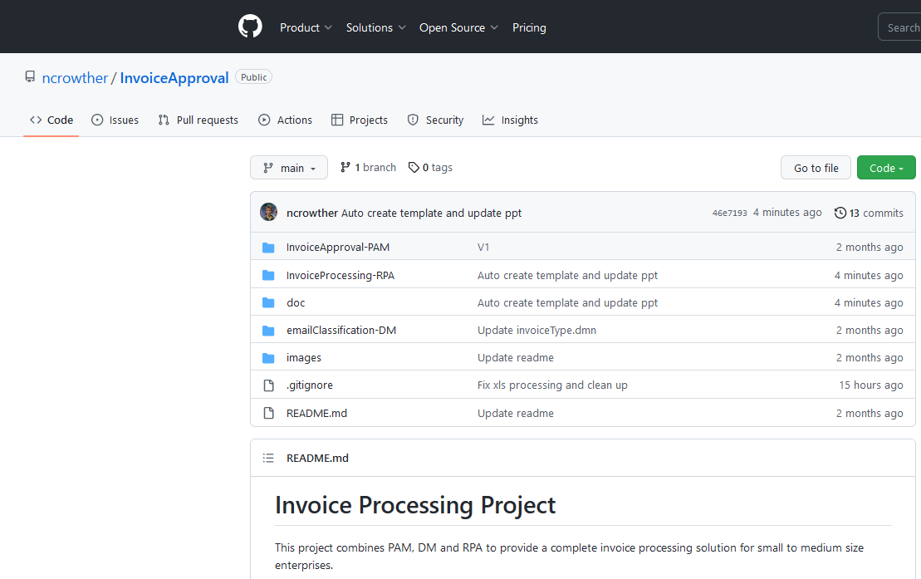
Asset on GitHub
https://github.com/ncrowther/InvoiceApproval
Free to use
Contribute!

Slide 13
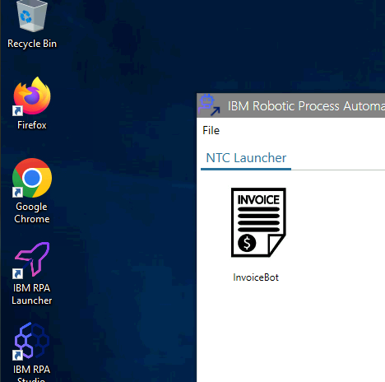
Demo

Slide 14


